Slide 1
Basic Tools
NTU week 1
chiffoncake & alxlai

Slide 2
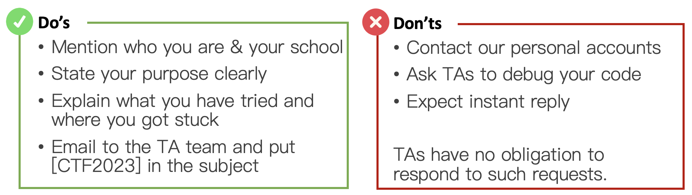
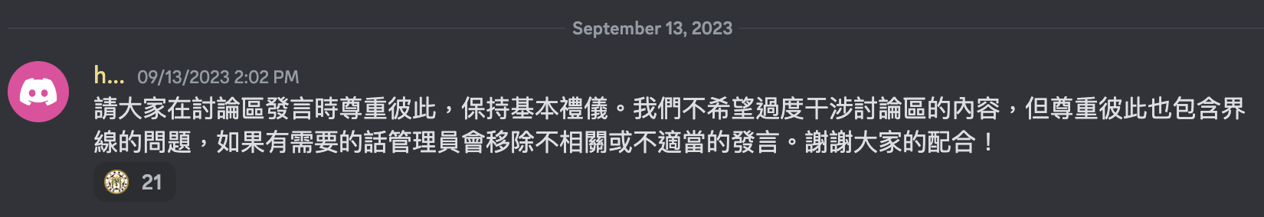
Course Announcement
Etiquette to ensure timely response & effective communication
Direct Communication
Broadcast Communication

Slide 3
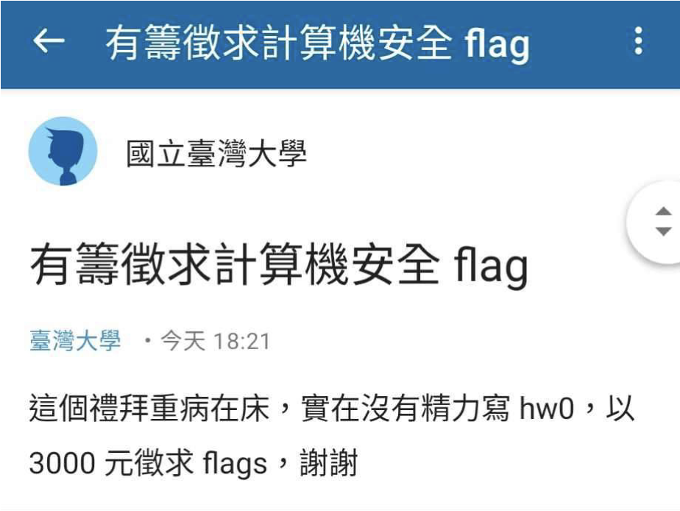
請這位同學不要加簽本課程
若這位同學仍然進入本課程，教學團隊會將真實身份提國立臺灣大學學生獎懲委員會處分，情節重大者依校規可處以退學處分
「酬」

Slide 4
Reminders
The course authorization code is sent to your NTU email, if you have gained more than 60 points in HW0.
This course is, and will be, recorded and uploaded. You’re encouraged to interrupt the speaker to ask a question, or you can review the video after the class.

Slide 5
The aim of this course
Get you familiar with very very very common tools
Not cover EVERYTHING you’ll need
Not teach you the techniques/concepts/terminology that should be taught later
Give you some keywords to search for after class

Slide 6
Outline
announcement and reminder
the aim of this course
speakers
balsn
tools
crypto
binary (reverse, pwn)
web
misc

Slide 7

$ whoami
蔡奇夆, R11922093
https://github.com/ktpss95112
CS 2021 Fall - TA
CNS 2022 Spring - TA
CNS 2023 Spring - TA
member of NSLab
member of Balsn
DEFCON 30, DEFCON 31
Notes:
https://docs.google.com/document/d/1KEh8LXP91iCQJfEmDwONTfgSOjKVhYrQ8pe8L2zLYg4/edit

Slide 8

$ whoami
alxlai
B09902135
CS 2021 Fall - student
CS 2022 Fall - TA
member of Balsn
member of NSLab

Slide 9
Balsn
balsn

Slide 10

$ groups
Balsn
CTF team from NSLab
https://balsn.tw/

Slide 11
Balsn CTF
Oct. 07 10:00 UTC+8 — Oct. 09 10:00 UTC+8
Top Team qualify HITCON CTF Final

Slide 12
Cryptography
crypto

Slide 13
Programming Language
Python / C++(?) / … Whatever you want
Sage !

Slide 14
Sage !
GF (Galois Field)
System of Equations
Polynomial Ring
Factorize
Discrete Log
Elliptic Curve
LLL
…

Slide 15
Useful Tools/Packages / Website
pycryptodome (AES, RSA, isPrime…..)
factordb
Z3
hashcat
cocalc

Slide 16
Binary Analysis / Exploitation
pwn & reverse

Slide 17
Reverse Engineering - Disassemblers
objdump
radare2
Notes:
賴

Slide 18
Reverse Engineering - Decompilers
IDA Pro
IDA Freeware
Powerful!
Ghidra
Cutter
Decompiler Explorer
Notes:
賴

Slide 19
Reverse Engineering - Others
readelf
checksec
Notes:
賴

Slide 20
Debuggers - Windows
x32dbg / x64dbg
CheatEngine
Windbg
Notes:
賴

Slide 21
Debuggers - *nix
cheat sheet
r
r < in
b main
b 10
b *0x860040
i b
c
n
ni
s
si
fin
bt
p $rax
p/x $rax
p *arr@10
x/6gx 0x860040
x/10i main
x/s 0x860040
rec
lay reg
lay asm
focus reg
help b
help r
…
gdb -tui
gcc -g -O0 main.c
gdb
peda + pwngdb
pwndbg
gef
…
and you need to change ~/.gdbinit
Notes:
蔡

Slide 22
pwntools
cheat sheet
r = remote(host, port)
r = process(executable)
r.interactive()
r.recvuntil("> ")
r.sendlineafter("1337")
p64 # p32, p16, p8
u64 # u32, u16, u8
b64d # b64e
md5sumhex
Try it out!
pwntools-practice

Slide 23
Web Security
web

Slide 24
Hands on!
web-practice

Slide 25
Sending HTTP Request
curl
Postman
Python - requests
Python - aiohttp
JavaScript - fetch()

Slide 26
Inspect Network Traffic / Packets
wireshark
BurpSuite

Slide 27
Obtaining Public IP to Send Back Flag
CSIE Workstation
ngrok
Or use online tools …
https://webhook.site/
https://requestcatcher.com/
https://typedwebhook.tools/
…

Slide 28
Warning!
Most CTF challenges do not require any form of “online brute-forcing”.
Think twice before you go on!
Notes:
dirbuster sqlmap subbrute

Slide 29
Website Inspection / Analysis
F12
elements
sources
network
application > storage > cookies
wappalyzer

Slide 30
Miscellaneous
misc

Slide 31
Some tools
https://github.com/zardus/ctf-tools

Slide 32
Q&A
… and good luck!
Thanks for your attention!

